Slide 1

數位語音處理概論
Introduction to Digital Speech Processing
9.0 Speech Recognition Updates
授課教師：國立臺灣大學 電機工程學系 李琳山 教授
【本著作除另有註明外，採取創用CC「姓名標示－非商業性－相同方式分享」臺灣3.0版授權釋出】

Slide 2
Minimum-Classification-Error (MCE) and Discriminative Training
A Primary Problem with the Conventional Training Criterion : Confusing sets
find λ^{(i)} such that P(X|λ^{(i)}) is maximum (Maximum Likelihood) if X ∈C_{i}
This does not always lead to minimum classification error, since it doesn't consider the mutual relationship among competing classes
The competing classes may give higher likelihood function for the test data
General Objective : find an optimal set of parameters (e.g. for recognition models) to minimize the expected error of classification
the statistics of test data may be quite different from that of the training data
training data is never enough
Assume the recognizer is operated with the following classification principles : {C_{i}, i=1,2,...M}, M classes
λ^{(i)}: statistical model for C_{i}
Λ={λ^{(i)}}_{i=1……M} , the set of all models for all classes
X : observations g_{i}(X,Λ): class conditioned likelihood function, for example, g_{i}(X,Λ) = P (X|λ^{(i)})
C(X) = C_{i} if g_{i}(X,Λ) = max_{j} g_{j}(X,Λ) : classification principles
an error happens when P(X|λ^{(i)}) = max but X ∉C_{i}

Slide 3
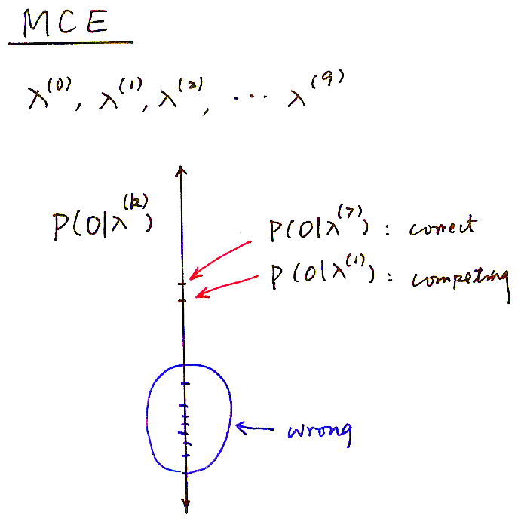
Minimum-Classification-Error (MCE)
λ⁽⁰⁾, λ⁽¹⁾, λ⁽²⁾,… λ⁽⁹⁾
P (O|λ^{(k)})
P (O|λ⁽⁷⁾)：correct
P (O|λ⁽¹⁾)：competing
wrong

Slide 4
Minimum-Classification-Error (MCE) Training
One form of the misclassification measure
Comparison between the likelihood functions for the correct class and the competing classes
A continuous loss function is defined
l(d) →0 when d →-∞
l(d) →1 when d →∞
θ: switching from 0 to 1 near θ
γ: determining the slope at switching point
Overall Classification Performance Measure :

Slide 5
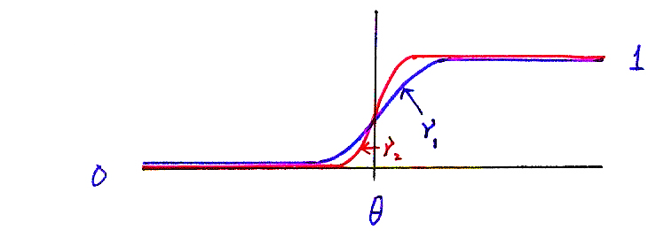
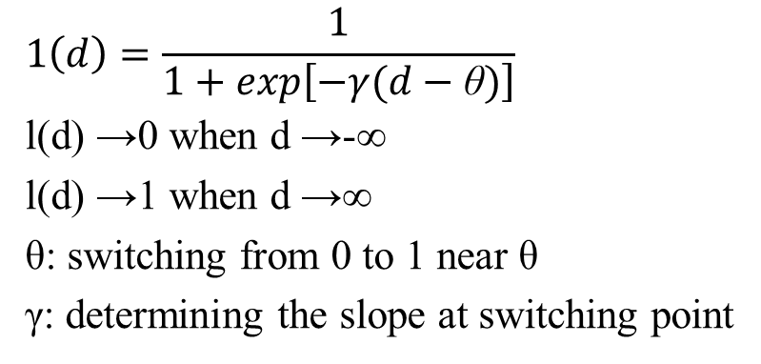
Sigmoid Function
$$1\left(d\right)=\frac{1}{1+exp\left[−γ(d−\text{θ})\right]}$$
l(d) →0 when d →-∞
l(d) →1 when d →∞
θ: switching from 0 to 1 near θ
γ: determining the slope at switching point
0
θ
γ₂
γ₁

Slide 6
Minimum-Classification-Error (MCE) Training
^
Find Λ such that
the above objective function in general is difficult to minimize directly
local minimum can be obtained iteratively using gradient (steepest) descent algorithm
every training observation may change the parameters of ALL models, not the model for its class only
partial differentiation with respect to all different parameters individually
t : the t-th iteration
ε: adjustment step size, should be carefully chosen

Slide 7
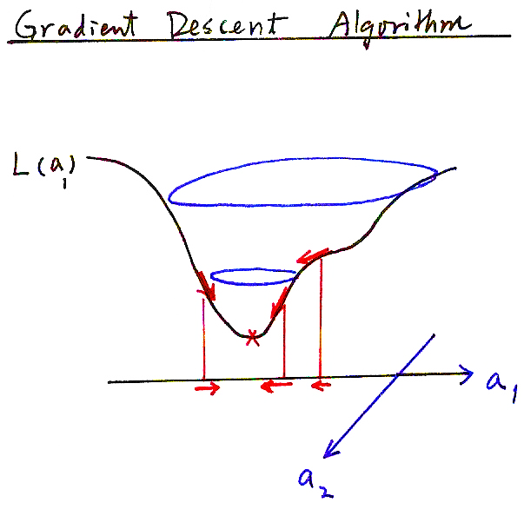
Gradient Descent Algorithm
L(a₁)
a₁
a₂

Slide 8
Discriminative Training and Minimum Phone Error Rate (MPE) Training For Large Vocabulary Speech Recognition
Minimum Bayesian Risk (MBR)
adjusting all model parameters to minimize the
Bayesian Risk
Λ: {λ_{i},i=1,2,……N} acoustic models
Γ: Language model parameters
O_{r} : r-th training utterance
s_{r}: correct transcription of O_{r}
Bayesian Risk
u: a possible recognition output found in the lattice
L(u,s_{r}) : Loss function
P_{Λ,Γ} (u|O_{r}) : posteriori probability of u given O_{r} based on Λ,Γ
Other definitions of L(u,s_{r}) possible
Minimum Phone Error Rate (MPE) Training
Acc(u,s_{r}) : phone accuracy
Better features obtainable in the same way
e.g. y_{t} = x_{t} + Mh_{t} feature-space MPE

Slide 9
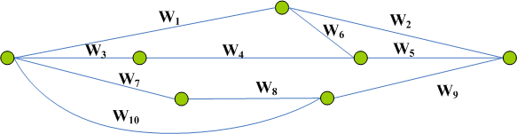
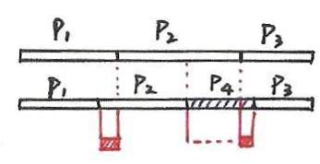
Minimum Phone Error (MPE) Rate Training
Lattice
Phone Accuracy
Time
Reference phone sequence
Decoded phone sequence
for a path in the lattice

Slide 10
References for MCE, MPE and Discriminative Training
“ Minimum Classification Error Rate Methods for Speech Recognition”, IEEE Trans. Speech and Audio Processing, May 1997
“Segmental Minimum Bayes-Rick Decoding for Automatic Speech Recognition”, IEEE Trans. Speech and Audio Processing, 2004
“Minimum Phone Error and I-smoothing for Improved Discriminative Training”, International Conference on Acoustics, Speech and Signal Processing, 2002
“Discriminative Training for Automatic Speech Recognition”, IEEE Signal Processing Magazine, Nov 2012

Slide 11
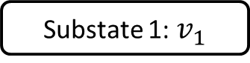
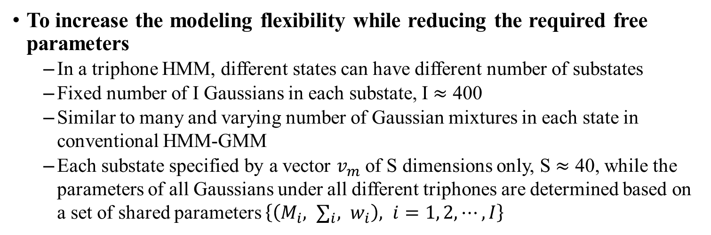
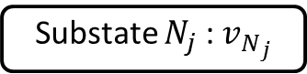
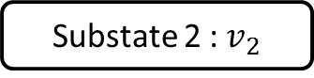
Subspace Gaussian Mixture Model
To increase the modeling flexibility while reducing the required free parameters
In a triphone HMM, different states can have different number of substates
Fixed number of I Gaussians in each substate, I $≈$ 400
Similar to many and varying number of Gaussian mixtures in each state in conventional HMM-GMM
Each substate specified by a vector $v_{m}$ of S dimensions only, S $≈$ 40, while the parameters of all Gaussians under all different triphones are determined based on a set of shared parameters $\left\{\left(M_{i}, ∑_{i}, w_{i}\right), i=1, 2, ⋯, I\right\}$
( HMM State )_{j}
substate weight vector
Substate 1:${ v}_{1}$
Substate 2 :${ v}_{2}$
Substate $N_{j}$ :${ v}_{N_{j}}$
Gaussian 1
Gaussian 2
Gaussian I
Gaussian 1
Gaussian 2
Gaussian I
…
Gaussian 1
Gaussian 2
Gaussian I
…
…
…

Slide 12
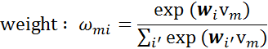
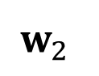
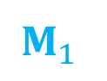
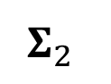
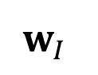


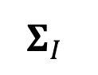

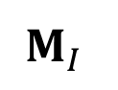
Subspace Gaussian Mixture Model
A triphone HMM in Subspace GMM
HMM
HMM State
HMM State
HMM State
Substate
v₁
…
v₂
v₃
…
v₄
v₅
…
v₆
Gaussian
…
…
…
…
…
…
$$M_{1}$$
$$M_{2}$$
$$M_{I}$$
Shared
Shared Parameters
$$Σ_{1}$$
$$Σ_{2}$$
$$Σ_{I}$$
…
$$w_{1}$$
$$w_{2}$$
$$w_{I}$$
I $≈$ 400, $v_{m}$: S dimensional, S $≈$ 40

Slide 13
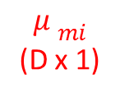
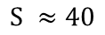
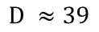
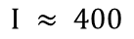
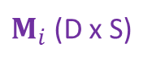
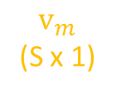
Subspace Gaussian Mixture Model
A triphone HMM in Subspace GMM
HMM
HMM State
HMM State
HMM State
Substate
v₁
…
v₂
v₃
…
v₄
v₅
…
v₆
Gaussian
…
…
…
…
…
…
$M_{i}$ (D x S)
$$I ≈ 400$$
$$M_{1}$$
$$M_{2}$$
$$M_{I}$$
$$D ≈39$$
$$S ≈40$$
$${μ }_{mi}$$
(D x 1)
$$v_{m}$$
(S x 1)
M_{i} is the basis set spanning a subspace of mean (columns of M_{i} not necessarily orthogonal)
Shared Parameters
$$Σ_{1}$$
$$Σ_{2}$$
$$Σ_{I}$$
…
=
…
…
…
$$w_{1}$$
$$w_{2}$$
$$w_{I}$$

Slide 14
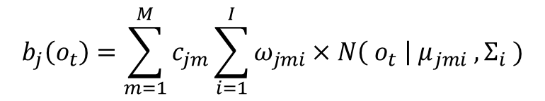
Subspace Gaussian Mixture Model
A triphone HMM in Subspace GMM
HMM
HMM State
HMM State
HMM State
Substate
v₁
…
v₂
v₃
…
v₄
v₅
…
v₆
Gaussian
…
…
…
…
…
…
$$M_{1}$$
$$M_{2}$$
$$M_{I}$$
The likelihood of HMM state j given o_{t}
Shared Parameters
$$Σ_{1}$$
$$Σ_{2}$$
$$Σ_{I}$$
$$b_{j}\left(o_{t}\right)=\sum_{m=1}^{M}{c_{jm}\sum_{i=1}^{I}{ω_{jmi}×N\left({ o}_{t} \right| μ_{jmi} , Σ_{i} )}}$$
…
$$w_{1}$$
$$w_{2}$$
$$w_{I}$$
j: state, m:substate, i: Gaussian

Slide 15
References for Subspace Gaussian Mixture Model
"The Subspace Gaussian Mixture Model– a Structured Model for Speech Recognition", D. Povey, Lukas Burget et. al Computer Speech and Language, 2011
"A Symmetrization of the Subspace Gaussian Mixture Model", Daniel Povey, Martin Karafiat, Arnab Ghoshal, Petr Schwarz, ICASSP 2011
"Subspace Gaussian Mixture Models for Speech Recognition", D. Povey, Lukas Burget et al., ICASSP 2010
"A Tutorial-Style Introduction To Subspace Gaussian Mixture Models For Speech Recognition", Microsoft Research technical report MSR-TR-2009-111

Slide 16
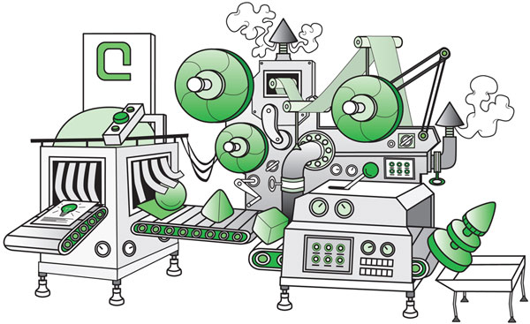

Neural Network — Classification Task
Features
Classifier
Classes
Male
Hair Length
Make-up
.
.
.
Classifier
Female
Others
Notes:
舉例而言 若要針對這房間裡的人 做性別的分類

Slide 17
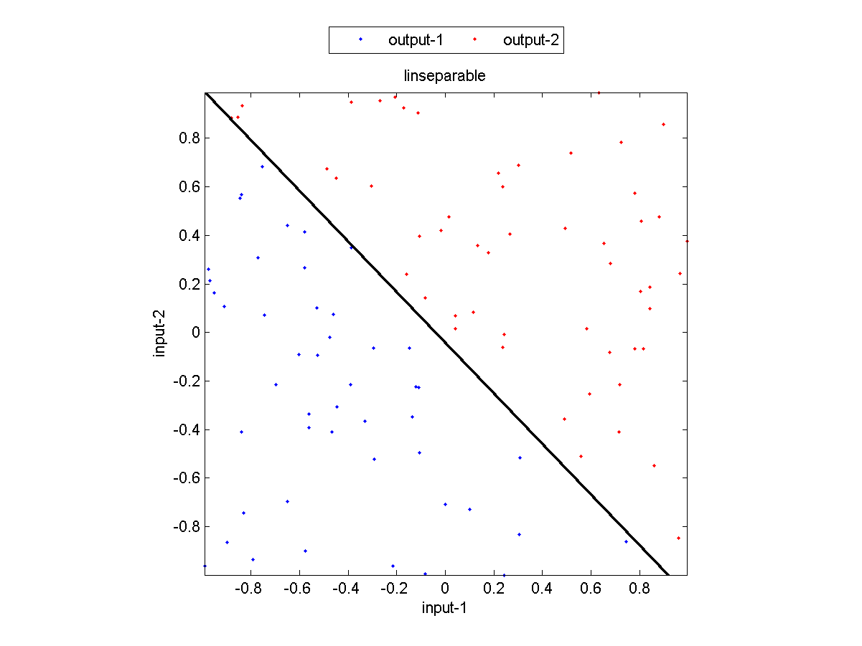
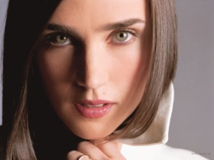

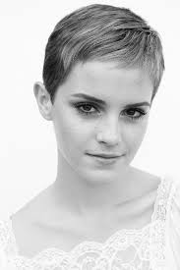
Neural Network — 2D Feature Space
Female
Make-Up
Male
Hair Length
Voice pitch

Slide 18
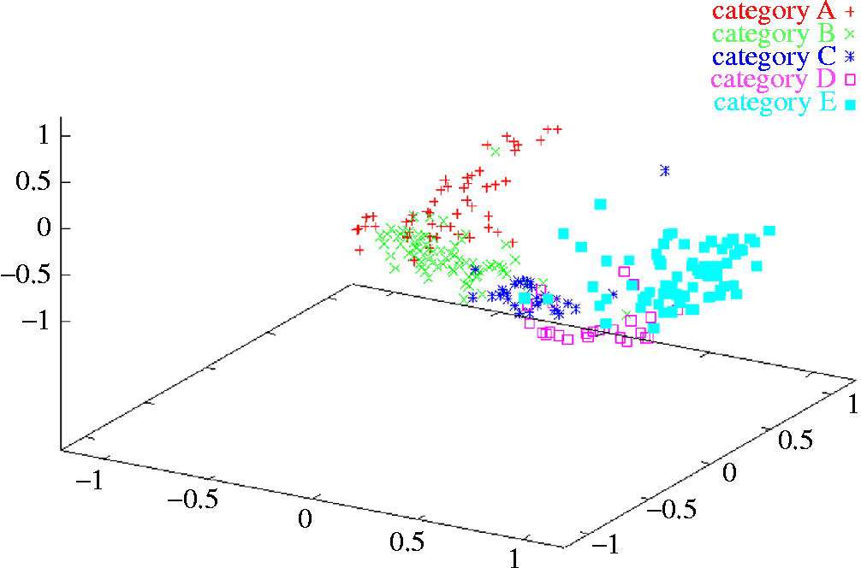
Neural Network ‒ Multi-Dimensional Feature Space
We need some type of non-linear function!

Slide 19
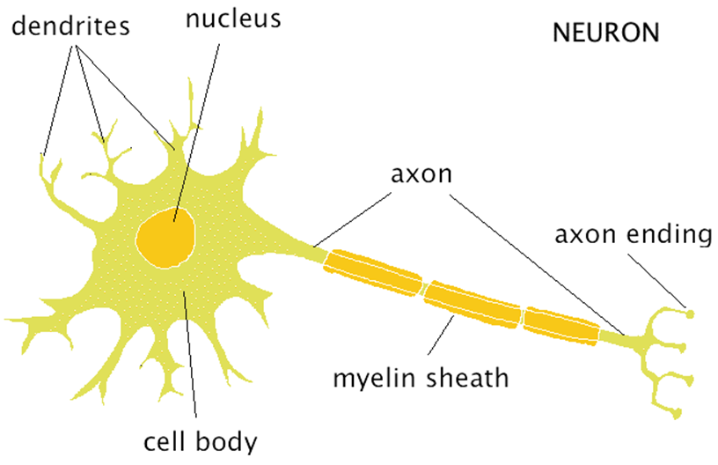

Neural Network — Neurons
Each neuron receives inputs from other neurons
The effect of each input on the neuron is adjustable (weighted)
The weights adapt so that the whole network learns to perform useful tasks

Slide 20

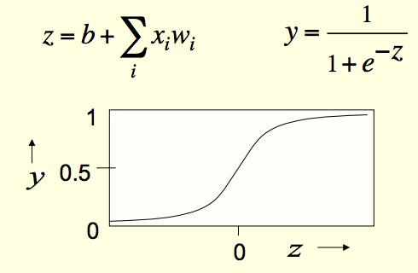

Neural Network
x1
x2
w1
w2
x3
w3
y
w4
x4
b
1
A lot of simple non-linearity → complex non-linearity

Slide 21
Neural Network Training – Back Propagation
Start with random weights
Compare the outputs of the net to the targets
Try to adjust the weights to minimize the error
yj
tj
Target
1
0.2
0
4
0.9
1
-3
w

Slide 22
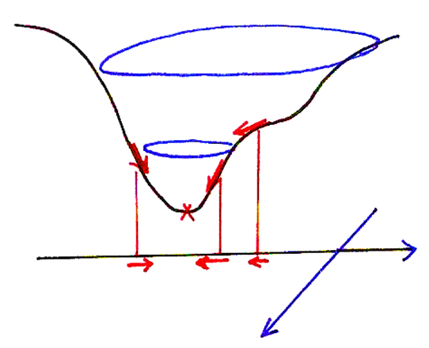
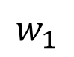
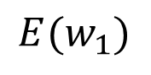
Gradient Descent Algorithm
$${E(w}_{1})$$
$$w_{1}$$
$$w_{2}$$

Slide 23

Gradient Descent Algorithm
x1
w1
x2
w2
x3
Error
w3
x4
w4
w2
w1
Updated weights
Learning rate
Weight at t-th iteration

Slide 24
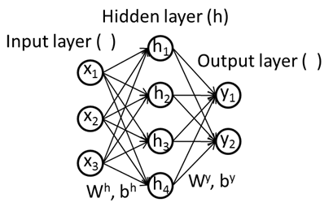
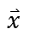
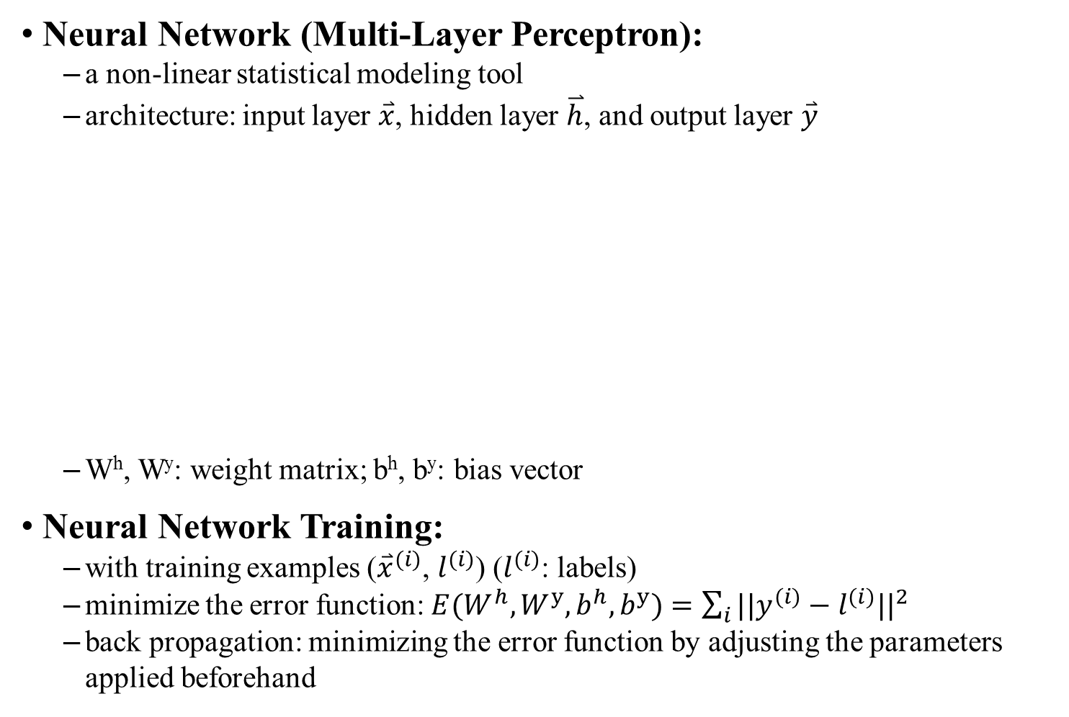
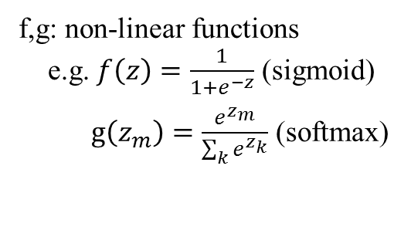
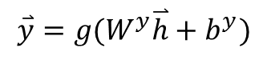
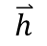
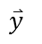
Neural Network — Formal Formulation
Neural Network (Multi-Layer Perceptron):
a non-linear statistical modeling tool
architecture: input layer $\overset{⃑}{x}$, hidden layer $\overset{⃑}{h}$, and output layer $\overset{⃑}{y}$
W^{h}, W^{y}: weight matrix; b^{h}, b^{y}: bias vector
Neural Network Training:
with training examples (${\overset{⃑}{x}}^{(i)}$, $l^{(i)}$) ($l^{(i)}$: labels)
minimize the error function: ${E(W}^{h},W^{y},b^{h},b^{y})=\sum_{i}{{||y^{(i)}−l^{(i)}||}^{2}}$
back propagation: minimizing the error function by adjusting the parameters applied beforehand
$$\overset{⃑}{h}$$
$$\overset{⃑}{x}$$
$$\overset{⃑}{h}=f(W^{h}\overset{⃑}{x}+b^{h})$$
$$\overset{⃑}{y}$$
$$\overset{⃑}{y}=g(W^{y}\overset{⃑}{h}+b^{y})$$
f,g: non-linear functions
e.g. $f\left(z\right)=\frac{1}{1+e^{−z}}$ (sigmoid)
$g\left(z_{m}\right)=\frac{e^{z_{m}}}{\sum_{k}{e^{z_{k}}}}$ (softmax)

Slide 25
References for Neural Network
Rumelhart, David E.; Hinton, Geoffrey E., Williams, Ronald J. "Learning representations by back-propagating errors". Nature, 1986.
Alpaydın, Ethem. Introduction to machine learning (2nd ed.), MIT Press, 2010.
Albert Nigrin, Neural Networks for Pattern Recognition(1st ed.). A Bradford Book, 1993.
Reference: Neural Networks for Machine Learning course by Geoffrey Hinton, Coursera

Slide 26
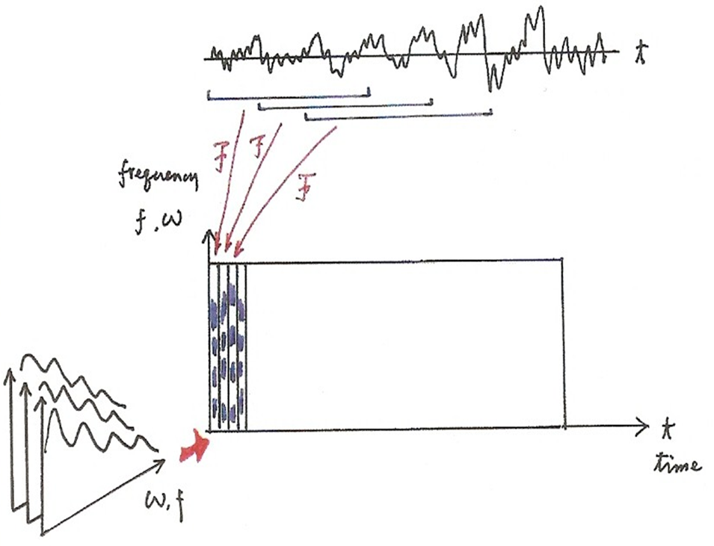
Spectrogram

Slide 27
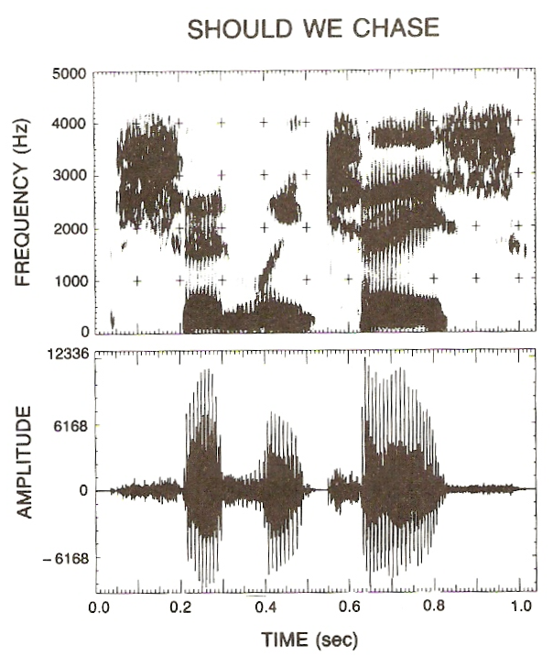
Spectrogram

Slide 28
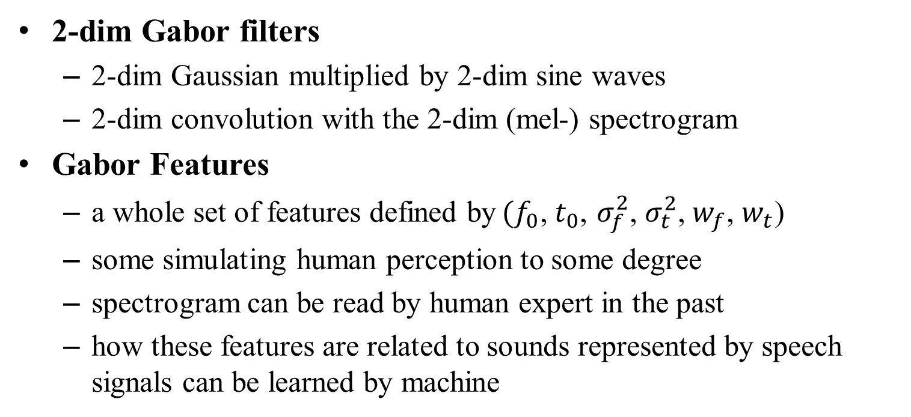
Gabor Features (1/2)
$G\left(t, f\right)=\frac{1}{2πσ_{f}σ_{t}}exp\left[\frac{{−(f−f_{0})}^{2}}{2σ_{f}^{2} }+\frac{{−(t−t_{0})}^{2}}{2σ_{t}^{2} }\right]exp\left[iw_{f}\left(f−f_{0}\right)+iw_{t}(t−t_{0})\right]$
2-dim Gabor filters
2-dim Gaussian multiplied by 2-dim sine waves
2-dim convolution with the 2-dim (mel-) spectrogram
Gabor Features
a whole set of features defined by$(f_{0}\text{,} t_{0}\text{,}$ $σ_{f}^{2}$, $σ_{t}^{2}\text{,}{ w}_{f}$, $w_{t}$)
some simulating human perception to some degree
spectrogram can be read by human expert in the past
how these features are related to sounds represented by speech signals can be learned by machine

Slide 29
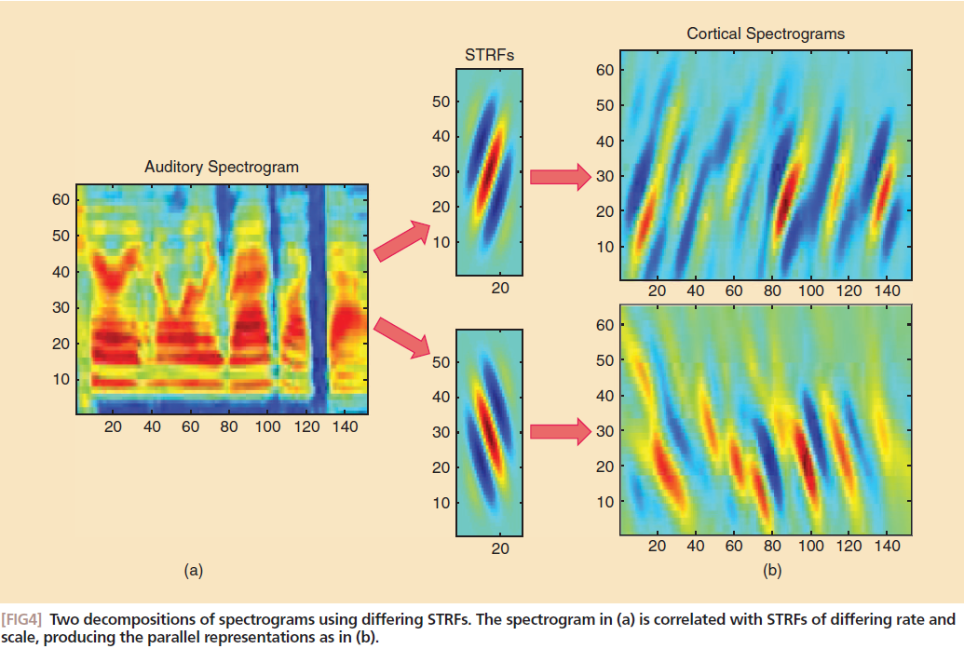
Gabor Features (2/2)

Slide 30
Integrating HMM with Neural Networks
Tandem System
Multi-layer Perceptron (MLP, or Neural Network) offers phoneme posterior vectors (posterior probability for each phoneme)
MLP trained with known phonemes for MFCC (or plus Gabor) vectors for one or several consecutive frames as target
phoneme posteriors concatenated with MFCC as a new set of features for HMM
phoneme posterior probabilities may need further processing to be better modeled by Gaussians
Hybrid System
Gaussian probabilities in each triphone HMM state replaced by state posteriors for phonemes from MLP trained by feature vectors with known state segmentation

Slide 31
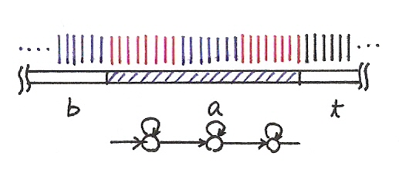
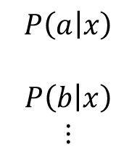
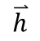
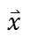
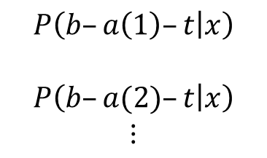
Phoneme Posteriors and State Posteriors
Neural Network Training
$$\overset{⃑}{h}$$
Phone
Posterior
State
Posterior
$$\overset{⃑}{x}$$
$$\overset{⃑}{y}$$
$$P\left(a | x\right)$$
$$P\left(b | x\right)$$
$$⋮$$
$$P\left(b–a\left(1\right)–t | x\right)$$
$$P\left(b–a(2)–t | x\right)$$
$$⋮$$

Slide 32
Integrating HMM with Neural Networks
Tandem System
phoneme posterior vectors from MLP concatenated with MFCC as a new set of features for HMM
Input
speech
Feature
Extraction
Decoding and
search
MFCC
output
Gabor
Language
Model
Acoustic
Models
MLP
Lexicon
concatenation
HMM
Training

Slide 33
Integrating HMM with Neural Networks
Tandem System
phoneme posterior vectors from MLP concatenated with MFCC as a new set of features for HMM
Input
speech
Feature
Extraction
Decoding and
search
MFCC
output
Gabor
Language
Model
Acoustic
Models
MLP
Lexicon
concatenation
HMM
Training

Slide 34
References
References for Gabor Features and Tandem System
Richard M. Stern & Nelson Morgan, “Hearing Is Believing”, IEEE SIGNAL PROCESSING MAGAZINE, NOVEMBER 2012
Hermansky, H., Ellis, D.P.W., Sharma, S., “Tandem Connectionist Feature Extraction For Conventional Hmm Systems”, in Proc. ICASSP 2000.
Ellis, D.P.W. and Singh, R. and Sivadas, S., “Tandem acoustic modeling in large-vocabulary recognition”, in Proc. ICASSP 2001.
“Improved Tonal Language Speech Recognition by Integrating Spectro-Temporal Evidence and Pitch Information with Properly Chosen Tonal Acoustic Units”, Interspeech, Florence, Italy, Aug 2011, pp. 2293-2296.

Slide 35








Deep Neural Network (DNN)
Deep Neural Network (DNN):
Neural network with multiple hidden layers
architecture: with input $\overset{⃑}{x}$, N hidden layers and output $\overset{⃑}{y}$
Property:
able to deal with huge and complicated structure of data
Difficulties:
large quantities of labelled data needed for training
very long training time needed
solution: Restricted Boltzmann Machine for initialization
$${\overset{⃑}{h}}^{(1)}=f(W_{0,1}\overset{⃑}{x}+b_{0,1})$$
$${\overset{⃑}{h}}^{(n)}=f(W_{n−1,n}{\overset{⃑}{h}}^{(n−1)}+b_{n−1,n})$$
$$\overset{⃑}{y}=g(W_{N,N+1}{\overset{⃑}{h}}^{(N)}+b_{N,N+1})$$
$$\overset{⃑}{x}$$
$$\overset{⃑}{y}$$
$${\overset{⃑}{h}}^{(1)}$$
$${\overset{⃑}{h}}^{(N)}$$

Slide 36



Restricted Boltzmann Machine
Restricted Boltzmann Machine (RBM):
a generative model for probability of visible examples (p(v))
with a hidden layer of random variables (h)
topology: undirected bipartite graph
W: weight matrix, describing correlation between visible and hidden layers
a, b: bias vectors for visible and hidden layers
E: energy function for a (v,h) pair
RBM training: adjusting W, a, and b to maximize p(v)
Property:
finding a good representation (h) for v in unsupervised manner
Using large quantities of unlabelled data

Slide 37



RBM Initialization for DNN Training
RBM Initialization
weight matrices of DNN initialized by weight matrixes of RBMs
after training an RBM, generate samples in hidden layer used for next layer of RBM
steps of initialization (e.g. 3 hidden layers)
1. RBM training
3. RBM training
5. RBM training
input samples
…
…
…
2. sampling
4. sampling
6. copy weight and bias as initialization
7. back propagation
DNN

Slide 38
Deep Neural Network for Acoustic Modeling
DNN as triphone state classifier
input: acoustic features, e.g. MFCC
output layer of DNN representing triphone states
fine tuning the DNN by back propagation using labelled data
Hybrid System
normalized output of DNN as posterior of states p(s|x)
state transition remaining unchanged, modeled by transition probabilities of HMM
HMM
DNN
s₁
a₁₁
MFCC frames (x)
a₁₂
…
s₂
a₂₂
…
s_{n}
a_{nn}

Slide 39

Bottleneck Features from DNN
P(a|x_{i})
P(b|x_{i})
P(c|x_{i})
……
……
Size of output layer = No. of states
DNN
new feature $x_{i}^{′}$
……
……
Acoustic feature
x_{i}
Notes:
一前一後地

Slide 40
References for DNN
Context-Dependent Pre-trained Deep Neural Networks for Large Vocabulary Speech Recognition
George E. Dahl, Dong Yu, Deng Li, and Alex Acero
IEEE Trans. on Audio, Speech and Language Processing, Jan, 2012
A fast learning algorithm for deep belief
Hinton, G. E., Osindero, S. and Teh, Y
Neural Computation, 18, pp 1527-1554, 2006
Deep Neural Networks for Acoustic Modeling in Speech Recognition
G. Hinton, L. Deng, D. Yu, G. Dahl, A.Mohamed, N. Jaitly, A. Senior, V. Vanhoucke, P. Nguyen, T. Sainath, and B. Kingsbury
IEEE Signal Processing Magazine, 29, November 2012
Deep Learning and Its Applications to Signal and Information Processing
IEEE Signal Processing Magazine, Jan 2011
Improved Bottleneck Features Using Pretrained Deep Neural Networks
Yu, Dong, and Michael L. Seltzer
Interspeech 2011
Extracting deep bottleneck features using stacked auto-encoders
Gehring, Jonas, et al.
ICASSP 2013

Slide 41

Convolutional Neural Network (CNN)
Successful in processing images
Speech can be treated as images
Spectrogram
Frequency
Time
Notes:
Spectrogram reading?
Spectrogram painting?
http://www.ultimaserial.com/UltimaSound.html
Taken an image
spectral waterfalls, voiceprints, or voicegram

Slide 42

Convolutional Neural Network (CNN)
An example
a₁
b₁
Max
Max
a₂
Max pooling
b₂

Slide 43

Convolutional Neural Network (CNN)
An example
CNN

Slide 44

Convolutional Neural Network (CNN)
An example
CNN
Probabilities of states
CNN
Replace DNN by CNN
Image
Notes:
Why it works?

Slide 45
Long Short-term Memory (LSTM)
Other part of the network
Special Neuron:
4 inputs,
1 output
Signal control the output gate
Output Gate
(Other part of the network)
Memory
Cell
Forget Gate
Signal control the forget gate
(Other part of the network)
Signal control the input gate
Input Gate
LSTM
(Other part of the network)
Other part of the network
Notes:
Normal neuron
1 input, 1 output
This one
4 input, 1 output

Slide 46


















Long Short-term Memory (LSTM)
$$a$$
$$=h\left(c^{′}\right)f\left(z_{o}\right)$$
$$z_{o}$$
multiply
Activation function f($⋅$) is usually a sigmoid function
$$f\left(z_{o}\right)$$
$$h\left(c^{′}\right)$$
between 0 and 1 for
opening and closing the gate
$$c$$
$$f\left(z_{f}\right)$$
c
$$c^{′}$$
$$z_{f}$$
$$cf\left(z_{f}\right)$$
$$f\left(z_{i}\right)$$
$$g\left(z\right)f\left(z_{i}\right)$$
$$c^{′}=g\left(z\right)f\left(z_{i}\right)+cf\left(z_{f}\right)$$
$$z_{i}$$
multiply
$$g\left(z\right)$$
$$z$$

Slide 47




Long Short-term Memory (LSTM)
Simply replacing the neurons with LSTM
original network
……
……
$$a_{1}$$
$$a_{2}$$
$$z_{1}$$
$$z_{2}$$
x₁
x₂
Input
Notes:
Use a same set of information
Note about the memory

Slide 48


Long Short-term Memory (LSTM)
$$a_{1}$$
$$a_{2}$$
+
+
+
+
+
+
+
+
4 times of parameters
x₁
x₂
Input
Notes:
Use a same set of information
Note about the memory

Slide 49
References
Convolutional Neural Network (CNN)
Convolutional Neural Network for Image processing
Zeiler, M. D., & Fergus, R. (2014). “Visualizing and understanding convolutional networks.” In Computer Vision–ECCV 2014
Convolutional Neural Network for speech processing
Tóth, László. "Convolutional deep maxout networks for phone recognition." Proc. Interspeech. 2014.
Convolutional Neural Network for text processing
Shen, Yelong, et al. "A latent semantic model with convolutional-pooling structure for information retrieval." Proceedings of the 23rd ACM International Conference on Conference on Information and Knowledge Management. ACM, 2014.
Long Short-term Memory (LSTM)
Graves, N. Jaitly, A. Mohamed. “Hybrid Speech Recognition with Deep Bidirectional LSTM”, ASRU 2013.
Graves, Alex, and Navdeep Jaitly. "Towards end-to-end speech recognition with recurrent neural networks." Proceedings of the 31st International Conference on Machine Learning (ICML-14). 2014.

Slide 50


Neural Network Language Modeling
Input words represented by 1-of-N encoding
[ 0 0 0 $⋯$ 0 1 0 0 $⋯$ 0 ]
Output layer gives the probabilities of words given the history
Prob $\left[{ w}_{j}=i\left|h_{j}\right. \right]$
Example:
P=120, H=800
Continuous space language modeling
vocabulary size

Slide 51

Recurrent Neural Network Language Modeling(RNNLM)
Probability distribution of next word, vocabulary size.
y(t): output layer
V
Recursive structure preserves long-term historical context.
s(t): hidden layer
U
Previous word, using 1-of-N encoding
0 0 0 ……… 0 0 1 0 0 0 …
Vocab. size
x(t):input layer

Slide 52



RNNLM Structure
x
$$s_{j}\left(t\right)=f\left(\sum_{i}{x_{i}(t)}u_{ji}+\sum_{l}{s_{l}(t−1)}w_{jl}\right)$$
$$y_{k}\left(t\right)=g\left(\sum_{j}{s_{j}(t)}v_{kj}\right)$$
Notes:
input layer: current work + previous word's neural network state
cuurent word in "1-of-N" encoding
current word is 1
all other words are 0
recurrency: implicit modeling of temporal context
hidden layer: neural network's "state"
the state is an abstract representation of sentence context
fulfills function of class-based n-gram LM
words with equivalent meanings correspond to similar/identical states
continuous space representation implicitly smoothes data
no need for Good-Turing, Kneser-Ney, etc.
f(z) function: sigmoid
output layer: one probability for every word in vocabulary
g(z) function: softmax
ensures that outputs form a proper probability function
all outputs are greater than 0, their sum is 1
intuitive view of how to calculate probabilities
vector-matrix multiplication
(input vector) x (matrix1) = (hidden layer)
(hidden layer) x (matrix2) = (output layer)
backpropagation training: rough idea
calculate error of output layer
error for ground truth word: 1 - (probability calculated by neural network)
error for all other words: 0 - (probability calculated by neural network)
propagate back to hidden and input layers to determine how much intermediate weights should be adjusted
stop training when weights converge

Slide 53
Back propagation for RNNLM
Unfold recurrent structure
Input one word at a time
Do normal back propagation
unfold
through time

Slide 54
References for RNNLM
Yoshua Bengio, Rejean Ducharme and Pascal Vincent. “A neural probabilistic language model,” Journal of Machine Learning Research, 3:1137–1155, 2003
Holger Schwenk. “Continuous space language models,” Computer Speech and Language, vol. 21, pp. 492–518, 2007
Tomáš Mikolov, Martin Karafiát, Lukáš Burget, Jan Černocký and Sanjeev Khudanpur. “Recurrent neural network based language model,” in Interspeech 2010
Mikolov Tomáš et al, “Extensions of Recurrent Neural Network Language Model”, ICASSP 2011.
Mikolov Tomáš et al, “Context Dependent Recurrent Neural Network Language Model”, IEEE SLT 2012.
Notes:
start-of-the-art: ngram + cache LM
has reigned supreme since 1991
most proposed advanced language modeling techniques provide only tiny improvements over simple baselines
often too complex for general use
rarely used in practice
examples
Maximum entropy n-gram models
Random forest LM

Slide 55
Word Vector Representations (Word Embedding)
0
z₁
1-of-N encoding
of the word w_{i-1}
1
z₂
The probability for each word as the next word w_{i}
0
……
……
…
……
Use the input of the neurons in the first layer to represent a word w
z₂
tree
flower
dog
rabbit
run
Word vector, word embedding feature: V(w)
Word analogy task: (king)-(man)+(woman)→(queen)
jump
cat
z₁
Notes:
Note that we only consider one input word, we only consider wi-1
We will consider multiple word
The structured is a little different

Slide 56
Word Vector Representations – Various Architectures
Continuous bag of word (CBOW) model
Skip-gram
w_{i-1}
Neural
Network
…… w_{i-1} ____ w_{i+1} ……
w_{i}
w_{i+1}
predicting the word given its context
…… ____ w_{i} ____ ……
Neural
Network
w_{i-1}
w_{i}
w_{i+1}
predicting the context given a word

Slide 57
References for Word Vector Representations
Tomas Mikolov, Kai Chen, Greg Corrado, and Jeffrey Dean. ”Efficient Estimation of Word Representations in Vector Space.” In Proceedings of Workshop at ICLR, 2013.
Tomas Mikolov, Ilya Sutskever, Kai Chen, Greg Corrado, and Jeffrey Dean. ”Distributed Representations of Words and Phrases and their Compositionality.” In Proceedings of NIPS, 2013.
Tomas Mikolov, Wen-tau Yih, and Geoffrey Zweig. ”Linguistic Regularities in Continuous Space Word Representations.” In Proceedings of NAACL HLT, 2013.

Slide 58



Weighted Finite State Transducer(WFST)
Finite State Machine
A mathematical model with theories and algorithms used to design computer programs and digital logic circuits, which is also called “Finite Automaton”.
The common automata are used as acceptors, which can recognize its legal input strings.
Acceptor
Accept any legal string, or reject it
EX: {ab, aab, aaab, . . .} = aa*b
Transducer
A finite state transducer (FST) is a extension to FSA
Transduce any legal input string to another output string, or reject it
EX: {aaa, aab, aba, abb} -> {bbb, bba, bab, baa}
Weighted Finite State Machine
FSM with weighted transition
An example of WFSA
Two paths for “ab”
Through states (0, 1, 1); cost is (0+1+2) = 3
Through states (0, 2, 4); cost is (1+2+2) = 5
initial state
final state
input
output
weight

Slide 59




WFST Operations (1/2)
Composition
Combining different levels of representation
T is the composition of $T_{1}$ and $T_{2}$ ⇒$T≡T_{1}° T_{2}$
The fact that T mapping u to w, implying $T_{1}$ mapping u to v, and $T_{2}$ mapping v to w.
$$T_{1}$$
$$T_{2}$$
$$T=T_{1}。 T_{2}$$
$$\left\{aa\right\}→\left\{ba\right\} :1.1$$
$$\left\{ba\right\}→\left\{cb\right\} :1.4$$
$\left\{aa\right\}→\left\{cb\right\} :\text{2.}$5

Slide 60



WFST Operations (2/2)
Minimization
The equivalent automaton with least number of states and least transitions
Weight pushing
Re-distributing weight among transitions while kept equivalent to improve search(future developments known earlier, etc.), especially pruned search
Weight Pushing
Minimization

Slide 61
WFST for ASR (1/6)
HCLG ≡ H ◦ C ◦ L ◦ G is the recognition graph
G is the grammar or LM (an acceptor)
L is the lexicon
C adds phonetic context-dependency
H specifies the HMM structure of context-dependent phones
 | Input | Output
H C L G | HMM state sequence triphone Phoneme sequence word | triphone phoneme word word

Slide 62

WFST for ASR (2/6)
Transducer H: HMM topology
Input: HMM state sequence
Output: context-dependent phoneme (e.g., triphone)
Weight: HMM transition probability
/a₀₀
$\left\{s_{0} s_{0} s_{0} s_{1} s_{1} s_{2}{ s}_{2} s_{2}\right\}→\left\{sh−ah−n\right\} :a_{00}a_{00}$ $a_{01}⋯$

Slide 63

WFST for ASR (3/6)
Transducer C: context-dependency
Input: context-dependent phoneme (triphone)
Output: context-independent phoneme (phoneme)
$ aba
a
b

Slide 64


WFST for ASR (4/6)
Transducer L: lexicon
Input: context-independent phoneme (phoneme) sequence
Output: word
Weight: pronunciation probability
$\left\{s, p, iy, ch\right\}→$ speech
$\left\{dh,ax \right\}→$ the

Slide 65

WFST for ASR (5/6)
Acceptor G: N-gram models
Bigram
Each word has a state
Each bigram w1w2 has a transition w1 to w2
Introducing back-off state b for back-off estimation.
An unseen w1w3 bigram is represented as two transitions: an ε-transition from w1 to b and a transition from b to w3.

Slide 66


WFST for ASR (6/6)
Acceptor U: utterance
Transition between the state labeled t-1 and the state labeled t giving the posterior probabilities for all HMM states given frame t
Decoding
$w^{′}={argmax}_{w} U。\left(H。C。L。G\right)$
$\left(H。C。L。G\right)$ replacing the conventional tree structure expanded by lexicon trees, built off-line
$U。\left(H。C。L。G\right)$ constructing a graph given U, over which all constraints or criteria for search can be applied
frame 1
frame 2
frame 3

Slide 67
References
WFST
Mehryar Mohri, “Finite-state transducers in language and speech processing,”Comput. Linguist., vol. 23, no. 2, pp. 269–311, 1997.
WFST for LVCSR
Mehryar Mohri, Fernando Pereira, and Michael Riley, “Weighted automata in text and speech processing,” in European Conference on Artificial Intelligence. 1996, pp. 46–50, John Wiley and Sons.
Mehryar Mohri, Fernando C. Pereira, and Michael Riley, “Speech Recognition with Weighted Finite-State Transducers,” in Springer Handbook of Speech Processing, Jacob Benesty, Mohan M. Sondhi, and Yiteng A. Huang, Eds., pp. 559–584. Springer Berlin Heidelberg, Secaucus, NJ, USA, 2008.

Slide 68
Prosodic Features (І)
Pitch-related Features (examples in Mandarin Chinese)
The average pitch value within the syllable
The maximum difference of pitch value within the syllable
The average of absolute values of pitch variations within the syllable
The magnitude of pitch reset for boundaries
The difference of such feature values of adjacent syllable boundaries ( P₁-P₂ , d₁-d₂ , etc.)
at least 50 pitch-related features
d₂
d₁
P₂
P₁

Slide 69
Prosodic Features (Ⅱ)
Duration-related Features (examples in Mandarin Chinese)
at least 40 duration-related features
Energy-related Features
similarly obtained
syllable boundary
pause
pause
syllable boundary
A
B
a
C
b
D
E
begin of utterance
end of utterance
Pause duration b
Average syllable duration
(B+C+D+E)/4 or ( (D+E)/2 + C )/2
Average syllable duration ratio
(D+E)/(B+C) or (D+E)/2 /C
Combination of pause & syllable
features (ratio or product)
C*b , D*b, C/b, D/b
Lengthening C / ( (A+B)/2 )
Standard deviation of feature values
Notes:
Then, let me describe the second set of features

Slide 70
Random Forest for Tone Recognition for Mandarin
Random Forest
a large number of decision trees
each trained with a randomly selected subset of training data and/or a randomly selected subset of features
decision for test data by voting of all trees
• • •

Slide 71
Recognition Framework with Prosodic Modeling
An example approach: Two-pass Recognition
Rescoring Formula:
Prosodic
model
λ_{l ,}λ_{p}: weighting coefficients
Notes:
Here we show the block diagram of the complete recognition process.
1-1 For each input speech utterance, the first pass produces a word graph using a baseline recognition system with the conventional acoustic and language models.
1-2 At this step, we have a top-down picture of a whole word graph. For Mandarin Chinese case, every word arc represents a lexical word which is composed of one to several syllables, represented by square blocks here. And each path implies a possible word sequence.
2. Then the second pass rescores every word arc by adding the prosodic probability. After rescoring every possible path, the system will choose the path with the highest score as the recognition results.
(翻到前頁)
3. The rescoring formula is based on this proposed equation. The final score of a word sequence W is the weighted sum of the acoustic log likelihood, the language model log probability and prosodic model log likelihood.
Next we will discuss this prosodic model

Slide 72
References
Prosody
“Improved Large Vocabulary Mandarin Speech Recognition by Selectively Using Tone Information with a Two-stage Prosodic Model”, Interspeech, Brisbane, Australia, Sep 2008, pp. 1137-1140
“Latent Prosodic Modeling (LPM) for Speech with Applications in Recognizing Spontaneous Mandarin Speech with Disfluencies”, International Conference on Spoken Language Processing, Pittsburgh, U.S.A., Sep 2006.
“Improved Features and Models for Detecting Edit Disfluencies in Transcribing Spontaneous Mandarin Speech”, IEEE Transactions on Audio, Speech and Language Processing, Vol. 17, No. 7, Sep 2009, pp. 1263-1278.
Random Forest
http://stat-www.berkeley.edu/users/breiman/RandomForests/cc_home.htm
http://stat-www.berkeley.edu/users/breiman/RandomForests/cc_papers.htm

Slide 73
Personalized Recognizer and Social Networks
Personalized recognizer is feasible today
Smart phone user is personal
each smart phone used by a single user
user identification is known once the smart phone is turned on
Personal corpus is available
Audio data easily collected at server
Text data available on social networks

Slide 74






Personalized Recognizer and Social Networks
Client
Recognition Module in the Cloud
Speech
Recognition Engine
Personal-ized LM
Personal-ized AM
Transcriptions
Language Model Adaptation
Acoustic Model Adaptation
Web Crawler
Social Network Corpora
Post transcriptions
Personalized Acoustic Data
User’s Wall
Friend 2
Friend 1
Friend 3
Social Network Cloud

Slide 75
Language Model Adaptation Framework
Social Network Cloud
target u
Training
Consolida-tion
Intermediate LM(s)
target u
Develop
Maximum
Likelihood
Interp.
Background LM
H: Personal Corpora
Collection
user
2
user
1
user
4
user
5
Recognition Engine
user
3
user
6
Personalized LM
Personalized AM

Slide 76
References for Personalized Recognizer
“Personalized Language Modeling by Crowd Sourcing with Social Network Data for Voice Access of Cloud Applications”, IEEE SLT 2012.
“Recurrent Neural Network Based Language Model Personalization by Social Network Crowdsourcing”, Interspeech 2013.

Slide 77

Recognizing Code-switched Speech
Definition
Code-switching occurs from word to word in an utterance
Example : 當我們要作 Fourier Transform 的時候
“Host” language
“Guest” language
Speech Recognition
Bilingual acoustic models, language model, and lexicon
A signal frame may belong to a Mandarin phoneme or an English phoneme, a Mandarin phoneme may be preceded or followed by an English phoneme and vice versa, a Chinese word may be preceded or followed by an English word and vice versa (bilingual triphones, bilingual n-grams, etc.)
Code-switched System
Acoustic Model
Speech Utterance
Mandarin
English
Language Model
Viterbi Decoding
Mandarin
English
Lexicon
Mandarin
English
這個complexity很高我買了iPad的配件

Slide 78
Recognizing Code-switched Speech
Code-switching issues
Imbalanced data distribution
There are much more data for host language but only very limited for guest language
The models for guest language are usually weak, therefore accuracy is low
Inter-lingual ambiguity
Some phonemes for different languages are very similar but different (e.g. ㄅ vs. B ), but may be produced very closely by the same speaker
Language identification (LID)
Units for LID are smaller than an utterance
Very limited information is available
Language Identification
這裡
是
在
講
Fourier
Transform
的
性質
Mandarin
English
Mandarin

Slide 79
Recognizing Code-switched Speech
Some approaches to handle the above problems
Acoustic unit merging and recovery
Some acoustic units shared across languages: Gaussian, state, model
Shared training data
Models recovered with respective data to preserve the language identity
Frame-level language identification (LID)
LID for each frame
Integrated in recognition
Triphone
Triphone
Triphone
Triphone
Triphone
Triphone
Integration of Language Identification and Speech Recognition
Code-mixed Speech
Bilingual
Acoustic
Model
Bilingual
Language
Model
State
State
State
State
Viterbi
Decoding
Procedure
Gaussian 1
Gaussian M
Gaussian 1
Gaussian
Gaussian M
Gaussian 1
Gaussian M
Language
Detector
Bilingual
Lexicon
Bilingual
Transcription

Slide 80
References for Recognizing Code-switched Speech
“Bilingual Acoustic Model Adaptation By Unit Merging On Different Levels And Cross-level Integration,” Interspeech, 2011.
“Recognition Of Highly Imbalanced Code-mixed Bilin-gual Speech With Frame-level Language Detection Based On Blurred Posteriorgram,” ICASSP, 2012.
“Language Independent And Language Adaptive Acoustic Modeling For Speech Recognition,” Tanja Schultz and Alex Waibel, Speech Communication, 2001.
“Learning Methods In Multilingual Speech Recognition,” Hui Lin, Li Deng, Jasha Droppo, Dong Yu, and Alex Acero, NIPS, 2008.

Slide 81

Speech-to-speech Translation
Source Language
Target Language
Speech
Text
Text
Speech
$$\left( \begin{aligned}\text{Speech} \\ \text{recognition} \end{aligned}\right)$$
Machine Translation
$$\left(\begin{aligned} Text\text{−}to\text{−}speech \\ \text{synthesis}\end{aligned}\right)$$
input
output
Language difference is a major problem in the globalized world
For N languages considered, ~ N² pairs of languages for translation
Human revision after machine translation feasible

Slide 82

Machine Translation — Simplified Formulation
Source language (Foreign) f:
word set (dictionary): F
a sentence: f = f₁f₂…f_{j}…f_{J}, f_{j}$∈$F, J: number of words
Target language (English) e:
word set (dictionary): E
a sentence: e = e₁e₂…e_{i}…e_{I}, e_{i}$∈$E, I: number of words
Statistical Machine Translation (SMT) task:
model $p\left(e | f\right)$
given a new source language sentence $f^{′}, e^{′}={argmax}_{e} p\left(e | f^{′}\right)$
$e^{′}={argmax}_{Y(f′)} p\left(e | f^{′}\right)$
$Y(f′)$: a smaller set of e considered
$p\left(e | f\right)=p\left(f | e\right)p(e)/p(f)∝p\left(f | e\right)p(e)$ (Bayesian theorem)
$p(e)$: language model
$p\left(f | e\right)$: translation model

Slide 83

Generative Models for SMT
Language model (p(e)):
conventional n-gram model
recurrent neural network
domain adaptation can be applied (corpus collection needed)
Translation model (p(f|e)):
$p\left(f | e\right)=\sum_{a}{p\left(f | e,a\right)p(a)}$, $a$: alignment
$p\left(f | e,a\right)$: unit (word/phrase) translation model
$p(a)$: reordering model
Example for an alignment:
f₁ f₂ f₃ f₄ f₅ f₆ f₇
For this example alignment a
$p(f|e, a)$= p(He|他)*p(is|是)…
$p(a)$= p(a: He<-->他, is<-->是,….)
All probabilities trained with parallel
bilingual corpora aligned or not
He is a professor of NTU .
他 是 一位 台大 的 教授。
e₁ e₂ e₃ e₄ e₅ e₆ e₇

Slide 84
Generative Models for SMT
Unit translation model p(f|e,a):
Based on unit translation table:
Examples:
Tables can be accumulated from training data
p(book|書) | 0.95
p(write|書) | 0.05
p(walk|走) | 0.8
p(leave|走) | 0.2

Slide 85
An Example of Reordering Model
Lexicalized reordering model:
model the orientation
orientation types: monotone(m), swap(s), discontinuous(d)
Ex. p(他<-->He,是<-->is…)=p( {他,He,(m)}, {是,is,(m)}, {一位,a,(d)},
{台大,NTU,(s)}, {的,of,(s)}, {教授,professor,(d)} )
m
他 是 一位 台大 的 教授 。
Probabilities trained with parallel bilingual corpora
m
d
s
s
d
He is a professor of NTU .

Slide 86

Modeling the Phrases

Slide 87

Decoding Considering Phrases
Phrase-based Translation
first source word covered
last source word covered
phrase translation considered
phrase translation probabilities trained

Slide 88
References for Translation
A Survey of Statistical Machine Translation
Adam Lopez
Tech. report of Univ. of Maryland
Statistical Machine Translation
Philipp Koehn
Cambridge University Press
Building a Phrase-based Machine Translation System
Kevin Duh and Graham Neubig
Lecture note of “Statistical Machine Translation,” NAIST, 2012 spring
Speech Recognition, Machine Translation, and Speech Translation ‒ A Unified Discriminative Learning Paradigm
IEEE Signal Processing Magazine, Sept 2011
Moses: Open Source Toolkit for Statistical Machine Translation
Annual Meeting of the Association for Computational Linguistics (ACL) demonstration session, Prague, Czech Republic, June 2007

Slide 89
References for Speech Recognition Updates
“Structured Discriminative Models for Speech Recognition”, IEEE Signal Processing Magazine, Nov 2012
“Subword Modeling for Automatic Speech Recognition”, IEEE Signal Processing Magazine, Nov 2012
“Machine Learning Paradigms for Speech Recognition ‒ An Overview”, IEEE Transactions on Audio, Speech and Language Processing, May 2013

Slide 90





版權聲明
頁碼 | 作品 | 版權標示 | 作者／來源
3 |  |  | 國立臺灣大學電機工程學系 李琳山 教授。 本作品採用創用CC「姓名標示-非商業性-相同方式分享3.0臺灣」許可協議。
5 |  |  | 國立臺灣大學電機工程學系 李琳山 教授。 本作品採用創用CC「姓名標示-非商業性-相同方式分享3.0臺灣」許可協議。
7 |  |  | 國立臺灣大學電機工程學系 李琳山 教授。 本作品採用創用CC「姓名標示-非商業性-相同方式分享3.0臺灣」許可協議。

Slide 91



版權聲明
頁碼 | 作品 | 版權標示 | 作者／來源
9 |  |  | 國立臺灣大學電機工程學系 李琳山 教授。 本作品採用創用CC「姓名標示-非商業性-相同方式分享3.0臺灣」許可協議。
9 |  |  | 國立臺灣大學電機工程學系 李琳山 教授。 本作品採用創用CC「姓名標示-非商業性-相同方式分享3.0臺灣」許可協議。
11 |  |  | 國立臺灣大學電機工程學系 李琳山 教授。 本作品採用創用CC「姓名標示-非商業性-相同方式分享3.0臺灣」許可協議。

Slide 92



版權聲明
頁碼 | 作品 | 版權標示 | 作者／來源
12 |  |  | 國立臺灣大學電機工程學系 李琳山 教授。 本作品採用創用CC「姓名標示-非商業性-相同方式分享3.0臺灣」許可協議。
13 |  |  | 國立臺灣大學電機工程學系 李琳山 教授。 本作品採用創用CC「姓名標示-非商業性-相同方式分享3.0臺灣」許可協議。
16 |  |  | Deviant art, by diddleh (http://www.deviantart.com/art/Alex-Turner-305306415) 瀏覽日期2017/03/26 本作品依據著作權法第 46、52、65 條合理使用。

Slide 93



版權聲明
頁碼 | 作品 | 版權標示 | 作者／來源
16 |  |  | Panglima Otomasi (https://panglimaotomasi.wordpress.com/) 瀏覽日期2017/03/26 本作品依據著作權法第 46、52、65 條合理使用。
17 |  |  | Fans share (http://cdn23.us1.fansshare.com/photos/jenniferconnelly/jennifer-connelly-requiem-for-dream-1052734967.jpg) 瀏覽日期2017/03/26 本作品依據著作權法第 46、52、65 條合理使用。
17 |  |  | 痞客邦 (https://cdn1-t17-techbang.pixcdn.tw/system/attached_images/2013/07/101414/original/97bf7b25dc5afe38a2b51bdb42887afa.jpg?1374803875) 瀏覽日期2017/03/26 本作品依據著作權法第 46、52、65 條合理使用。

Slide 94



版權聲明
頁碼 | 作品 | 版權標示 | 作者／來源
17 |  |  | Plurk (https://images.plurk.com/218276_8e002d77006c77014ad4d6908dded388.jpg) 瀏覽日期2017/03/26 本作品依據著作權法第 46、52、65 條合理使用。
17 |  |  | Deviant art, by diddleh (http://www.deviantart.com/art/Alex-Turner-305306415) 瀏覽日期2017/03/26 本作品依據著作權法第 46、52、65 條合理使用。
18 |  |  | 國立臺灣大學電機工程學系 李琳山 教授。 本作品採用創用CC「姓名標示-非商業性-相同方式分享3.0臺灣」許可協議。

Slide 95



版權聲明
頁碼 | 作品 | 版權標示 | 作者／來源
19 |  |  | The Neuron, by Dr. C. George Boeree (http://webspace.ship.edu/cgboer/theneuron.html) 瀏覽日期2017/03/26 本作品依據著作權法第 46、52、65 條合理使用。
19 |  |  | Neuroprevention (https://iberdiaz.wordpress.com/2014/07/03/15-neuroprevencion-de-riesgos/) 瀏覽日期2017/03/26 本作品依據著作權法第 46、52、65 條合理使用。
20 |  |  | 國立臺灣大學電機工程學系 李琳山 教授。 本作品採用創用CC「姓名標示-非商業性-相同方式分享3.0臺灣」許可協議。

Slide 96



版權聲明
頁碼 | 作品 | 版權標示 | 作者／來源
20 |  |  | 國立臺灣大學電機工程學系 李琳山 教授。 本作品採用創用CC「姓名標示-非商業性-相同方式分享3.0臺灣」許可協議。
21 |  |  | 國立臺灣大學電機工程學系 李琳山 教授。 本作品採用創用CC「姓名標示-非商業性-相同方式分享3.0臺灣」許可協議。
22 |  |  | 國立臺灣大學電機工程學系 李琳山 教授。 本作品採用創用CC「姓名標示-非商業性-相同方式分享3.0臺灣」許可協議。

Slide 97



版權聲明
頁碼 | 作品 | 版權標示 | 作者／來源
23 |  |  | Machine Learning by Andrew Ng (http://cs229.stanford.edu/) 瀏覽日期2017/03/26 本作品依據著作權法第 46、52、65 條合理使用。
24 |  |  | 國立臺灣大學電機工程學系 李琳山 教授。 本作品採用創用CC「姓名標示-非商業性-相同方式分享3.0臺灣」許可協議。
26 |  |  | 國立臺灣大學電機工程學系 李琳山 教授。 本作品採用創用CC「姓名標示-非商業性-相同方式分享3.0臺灣」許可協議。

Slide 98



版權聲明
頁碼 | 作品 | 版權標示 | 作者／來源
27 |  |  | 國立臺灣大學電機工程學系 李琳山 教授。 本作品採用創用CC「姓名標示-非商業性-相同方式分享3.0臺灣」許可協議。
29 |  |  | 國立臺灣大學電機工程學系 李琳山 教授。 本作品採用創用CC「姓名標示-非商業性-相同方式分享3.0臺灣」許可協議。
31 |  |  | 國立臺灣大學電機工程學系 李琳山 教授。 本作品採用創用CC「姓名標示-非商業性-相同方式分享3.0臺灣」許可協議。

Slide 99



版權聲明
頁碼 | 作品 | 版權標示 | 作者／來源
31 |  |  | 國立臺灣大學電機工程學系 李琳山 教授。 本作品採用創用CC「姓名標示-非商業性-相同方式分享3.0臺灣」許可協議。
32 |  |  | 國立臺灣大學電機工程學系 李琳山 教授。 本作品採用創用CC「姓名標示-非商業性-相同方式分享3.0臺灣」許可協議。
35 |  |  | 國立臺灣大學電機工程學系 李琳山 教授。 本作品採用創用CC「姓名標示-非商業性-相同方式分享3.0臺灣」許可協議。

Slide 100



版權聲明
頁碼 | 作品 | 版權標示 | 作者／來源
36 |  |  | 國立臺灣大學電機工程學系 李琳山 教授。 本作品採用創用CC「姓名標示-非商業性-相同方式分享3.0臺灣」許可協議。
37 |  |  | 國立臺灣大學電機工程學系 李琳山 教授。 本作品採用創用CC「姓名標示-非商業性-相同方式分享3.0臺灣」許可協議。
38 |  |  | 國立臺灣大學電機工程學系 李琳山 教授。 本作品採用創用CC「姓名標示-非商業性-相同方式分享3.0臺灣」許可協議。

Slide 101



版權聲明
頁碼 | 作品 | 版權標示 | 作者／來源
39 |  |  | 國立臺灣大學電機工程學系 李琳山 教授。 本作品採用創用CC「姓名標示-非商業性-相同方式分享3.0臺灣」許可協議。
41 |  |  | 國立臺灣大學電機工程學系 李琳山 教授。 本作品採用創用CC「姓名標示-非商業性-相同方式分享3.0臺灣」許可協議。
42 |  |  | 國立臺灣大學電機工程學系 李琳山 教授。 本作品採用創用CC「姓名標示-非商業性-相同方式分享3.0臺灣」許可協議。

Slide 102


版權聲明
頁碼 | 作品 | 版權標示 | 作者／來源
43 |  |  | Parallel Architecture Research Eindhoven (http://parse.ele.tue.nl/cluster/2/CNNArchitecture.jpg) 瀏覽日期2017/03/26 本作品依據著作權法第 46、52、65 條合理使用。
44 |  |  | Parallel Architecture Research Eindhoven (http://parse.ele.tue.nl/cluster/2/CNNArchitecture.jpg) 瀏覽日期2017/03/26 本作品依據著作權法第 46、52、65 條合理使用。
44 |  |  | 國立臺灣大學電機工程學系 李琳山 教授。 本作品採用創用CC「姓名標示-非商業性-相同方式分享3.0臺灣」許可協議。

Slide 103



版權聲明
頁碼 | 作品 | 版權標示 | 作者／來源
45 |  |  | 國立臺灣大學電機工程學系 李琳山 教授。 本作品採用創用CC「姓名標示-非商業性-相同方式分享3.0臺灣」許可協議。
46 |  |  | 國立臺灣大學電機工程學系 李琳山 教授。 本作品採用創用CC「姓名標示-非商業性-相同方式分享3.0臺灣」許可協議。
47 |  |  | 國立臺灣大學電機工程學系 李琳山 教授。 本作品採用創用CC「姓名標示-非商業性-相同方式分享3.0臺灣」許可協議。

Slide 104



版權聲明
頁碼 | 作品 | 版權標示 | 作者／來源
48 |  |  | 國立臺灣大學電機工程學系 李琳山 教授。 本作品採用創用CC「姓名標示-非商業性-相同方式分享3.0臺灣」許可協議。
50 |  |  | 國立臺灣大學電機工程學系 李琳山 教授。 本作品採用創用CC「姓名標示-非商業性-相同方式分享3.0臺灣」許可協議。
51 |  |  | 國立臺灣大學電機工程學系 李琳山 教授。 本作品採用創用CC「姓名標示-非商業性-相同方式分享3.0臺灣」許可協議。

Slide 105



版權聲明
頁碼 | 作品 | 版權標示 | 作者／來源
52 |  |  | 國立臺灣大學電機工程學系 李琳山 教授。 本作品採用創用CC「姓名標示-非商業性-相同方式分享3.0臺灣」許可協議。
53 |  |  | 國立臺灣大學電機工程學系 李琳山 教授。 本作品採用創用CC「姓名標示-非商業性-相同方式分享3.0臺灣」許可協議。
53 |  |  | 國立臺灣大學電機工程學系 李琳山 教授。 本作品採用創用CC「姓名標示-非商業性-相同方式分享3.0臺灣」許可協議。

Slide 106



版權聲明
頁碼 | 作品 | 版權標示 | 作者／來源
55 |  |  | 國立臺灣大學電機工程學系 李琳山 教授。 本作品採用創用CC「姓名標示-非商業性-相同方式分享3.0臺灣」許可協議。
55 |  |  | 國立臺灣大學電機工程學系 李琳山 教授。 本作品採用創用CC「姓名標示-非商業性-相同方式分享3.0臺灣」許可協議。
56 |  |  | 國立臺灣大學電機工程學系 李琳山 教授。 本作品採用創用CC「姓名標示-非商業性-相同方式分享3.0臺灣」許可協議。

Slide 107



版權聲明
頁碼 | 作品 | 版權標示 | 作者／來源
58 |  |  | 國立臺灣大學電機工程學系 李琳山 教授。 本作品採用創用CC「姓名標示-非商業性-相同方式分享3.0臺灣」許可協議。
58 |  |  | 國立臺灣大學電機工程學系 李琳山 教授。 本作品採用創用CC「姓名標示-非商業性-相同方式分享3.0臺灣」許可協議。
58 |  |  | 國立臺灣大學電機工程學系 李琳山 教授。 本作品採用創用CC「姓名標示-非商業性-相同方式分享3.0臺灣」許可協議。

Slide 108



版權聲明
頁碼 | 作品 | 版權標示 | 作者／來源
59 |  |  | 國立臺灣大學電機工程學系 李琳山 教授。 本作品採用創用CC「姓名標示-非商業性-相同方式分享3.0臺灣」許可協議。
60 |  |  | 國立臺灣大學電機工程學系 李琳山 教授。 本作品採用創用CC「姓名標示-非商業性-相同方式分享3.0臺灣」許可協議。
62 |  |  | 國立臺灣大學電機工程學系 李琳山 教授。 本作品採用創用CC「姓名標示-非商業性-相同方式分享3.0臺灣」許可協議。

Slide 109



版權聲明
頁碼 | 作品 | 版權標示 | 作者／來源
63 |  |  | 國立臺灣大學電機工程學系 李琳山 教授。 本作品採用創用CC「姓名標示-非商業性-相同方式分享3.0臺灣」許可協議。
64 |  |  | 國立臺灣大學電機工程學系 李琳山 教授。 本作品採用創用CC「姓名標示-非商業性-相同方式分享3.0臺灣」許可協議。
65 |  |  | 國立臺灣大學電機工程學系 李琳山 教授。 本作品採用創用CC「姓名標示-非商業性-相同方式分享3.0臺灣」許可協議。

Slide 110



版權聲明
頁碼 | 作品 | 版權標示 | 作者／來源
66 |  |  | 國立臺灣大學電機工程學系 李琳山 教授。 本作品採用創用CC「姓名標示-非商業性-相同方式分享3.0臺灣」許可協議。
68 |  |  | 國立臺灣大學電機工程學系 李琳山 教授。 本作品採用創用CC「姓名標示-非商業性-相同方式分享3.0臺灣」許可協議。
69 |  |  | 國立臺灣大學電機工程學系 李琳山 教授。 本作品採用創用CC「姓名標示-非商業性-相同方式分享3.0臺灣」許可協議。

Slide 111



版權聲明
頁碼 | 作品 | 版權標示 | 作者／來源
70 |  |  | 國立臺灣大學電機工程學系 李琳山 教授。 本作品採用創用CC「姓名標示-非商業性-相同方式分享3.0臺灣」許可協議。
71 |  |  | 國立臺灣大學電機工程學系 李琳山 教授。 本作品採用創用CC「姓名標示-非商業性-相同方式分享3.0臺灣」許可協議。
74 |  |  | 蘋果日報 (http://static.apple.nextmedia.com/images/apple-photos/apple/20140410/large/10wa102pt.jpg) 瀏覽日期2017/03/26 本作品依據著作權法第 46、52、65 條合理使用。

Slide 112



版權聲明
頁碼 | 作品 | 版權標示 | 作者／來源
74 |  |  | Facebook之留言紀錄。 瀏覽日期2017/03/26 本作品依據著作權法第 46、52、65 條合理使用。
74 |  |  | 痞客邦 (http://pic.pimg.tw/wonderfulunun/1182014965.jpg) 瀏覽日期2017/03/26 本作品依據著作權法第 46、52、65 條合理使用。
75 |  |  | 國立臺灣大學電機工程學系 李琳山 教授。 本作品採用創用CC「姓名標示-非商業性-相同方式分享3.0臺灣」許可協議。

Slide 113



版權聲明
頁碼 | 作品 | 版權標示 | 作者／來源
77 |  |  | 國立臺灣大學電機工程學系 李琳山 教授。 本作品採用創用CC「姓名標示-非商業性-相同方式分享3.0臺灣」許可協議。
78 |  |  | 國立臺灣大學電機工程學系 李琳山 教授。 本作品採用創用CC「姓名標示-非商業性-相同方式分享3.0臺灣」許可協議。
78 |  |  | 國立臺灣大學電機工程學系 李琳山 教授。 本作品採用創用CC「姓名標示-非商業性-相同方式分享3.0臺灣」許可協議。

Slide 114



版權聲明
頁碼 | 作品 | 版權標示 | 作者／來源
79 |  |  | 國立臺灣大學電機工程學系 李琳山 教授。 本作品採用創用CC「姓名標示-非商業性-相同方式分享3.0臺灣」許可協議。
79 |  |  | 國立臺灣大學電機工程學系 李琳山 教授。 本作品採用創用CC「姓名標示-非商業性-相同方式分享3.0臺灣」許可協議。
83 |  |  | 國立臺灣大學電機工程學系 李琳山 教授。 本作品採用創用CC「姓名標示-非商業性-相同方式分享3.0臺灣」許可協議。

Slide 115



版權聲明
頁碼 | 作品 | 版權標示 | 作者／來源
85 |  |  | 國立臺灣大學電機工程學系 李琳山 教授。 本作品採用創用CC「姓名標示-非商業性-相同方式分享3.0臺灣」許可協議。
86 |  |  | Moses statistical machine translation system (http://www.statmt.org/moses/?n=Moses.Background) 瀏覽日期2017/03/26 本作品依據著作權法第 46、52、65 條合理使用。
87 |  |  | Moses statistical machine translation system (http://www.statmt.org/moses/?n=Moses.Background) 瀏覽日期2017/03/26 本作品依據著作權法第 46、52、65 條合理使用。

